Slide 1

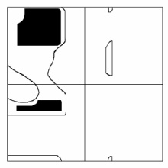
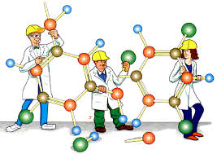
Primer to Computer Aided Drug Design - Insilico Methods
Dr. K. Gugan
Assistant Professor
CAS in Crystallography and Biophysics
University of Madras

Slide 2
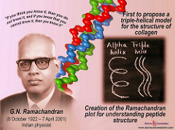
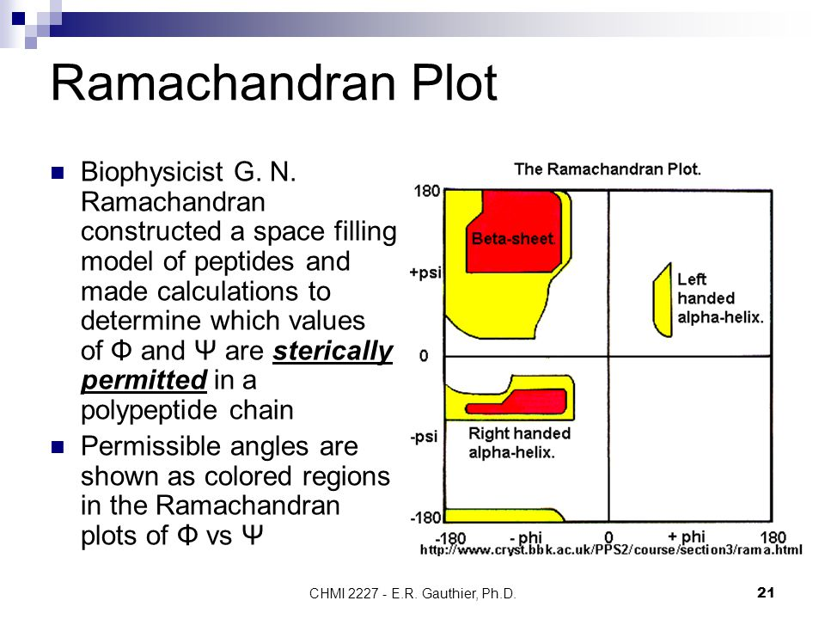
G.N. Ramachandran 8th of October 1922 – 7th of April, 2001

Slide 3
Things to know
Drug?
Mechanism of Action?
ADMET?
Drug Discovery?
In silico, in vitro, in vivo?

Slide 4
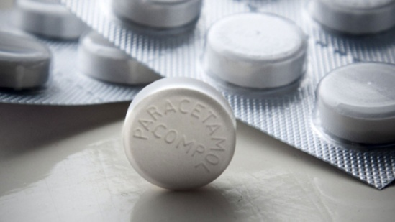
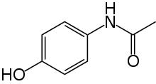
Drug
Drug?
Fever? Pain?
Diagnosis? Medication?
Cyclooxygenase (COX)
Paracetamol
N-acetyl-para-aminophenol (APAP), Acetaminophen

Slide 5
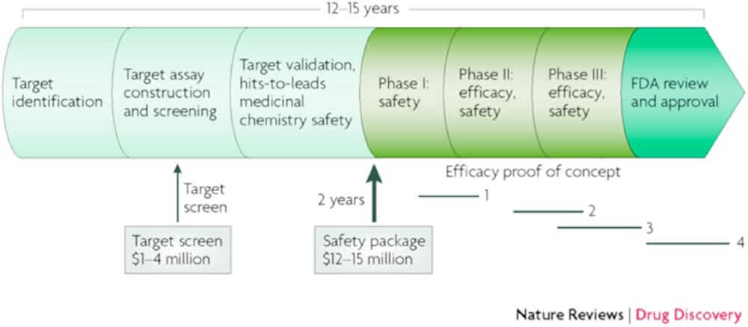
Drug Discovery Pipeline

Slide 6
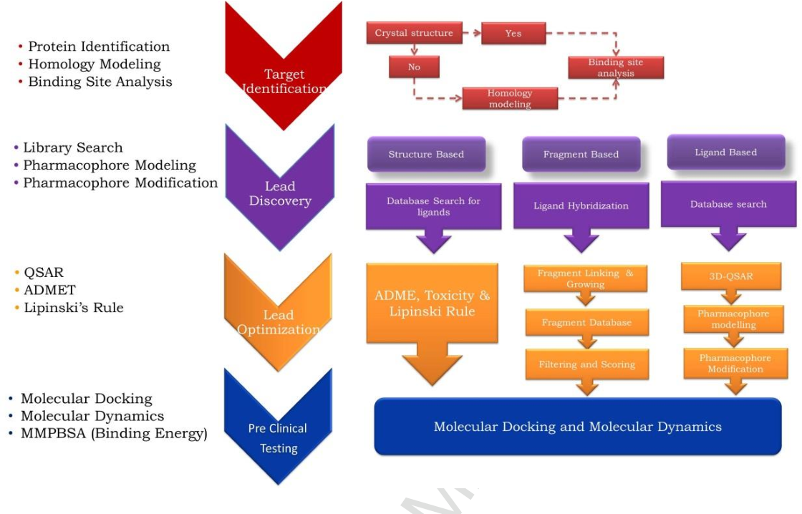
Computational Drug Discovery

Slide 7
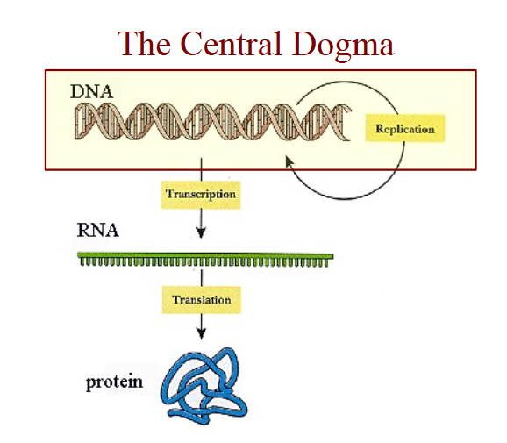

Slide 8
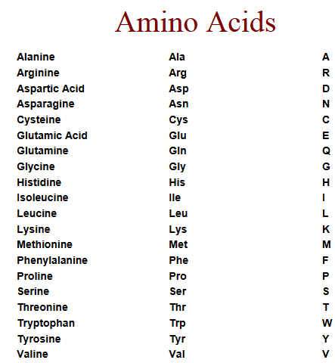
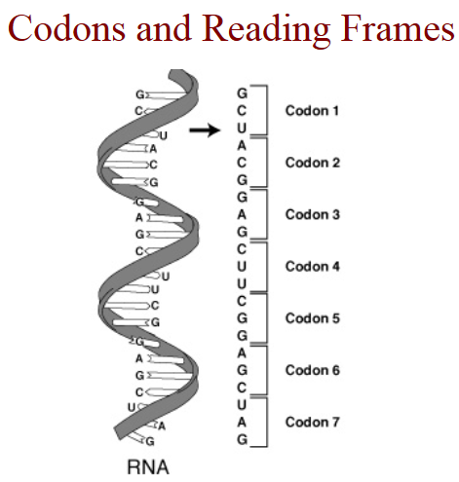
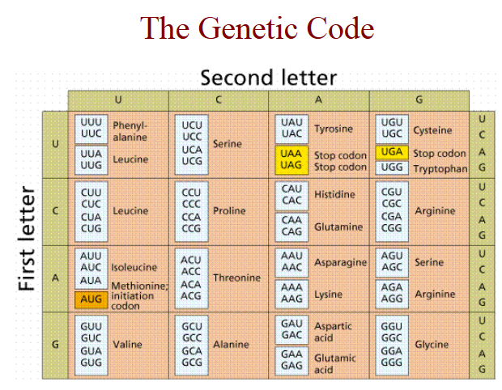

Slide 9
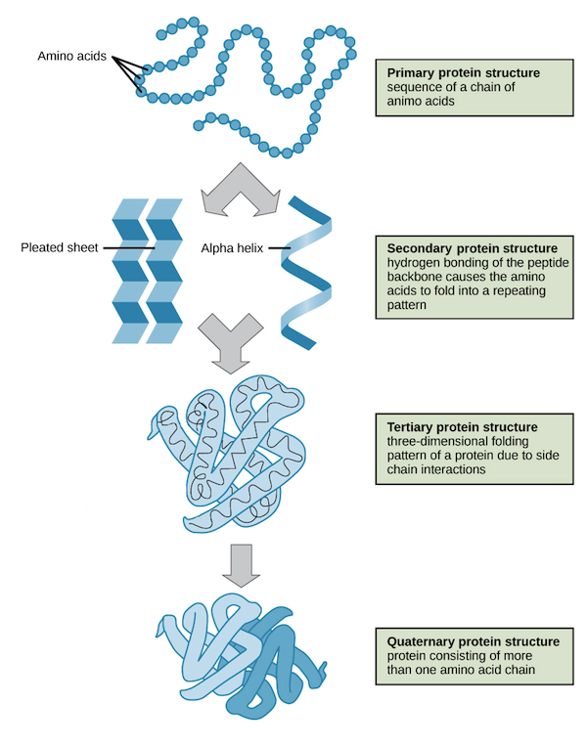
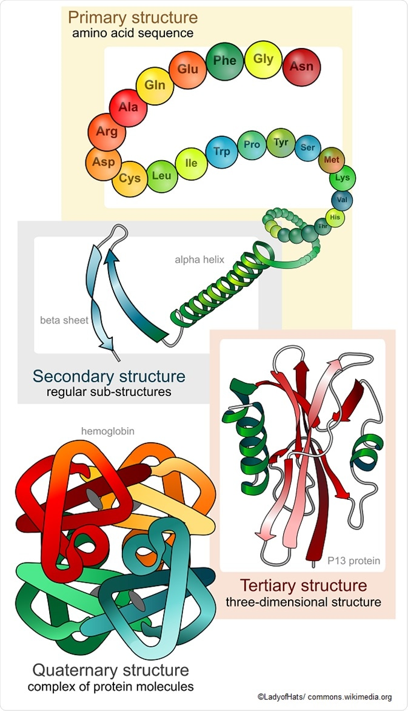
Proteins – Structure and Function

Slide 10
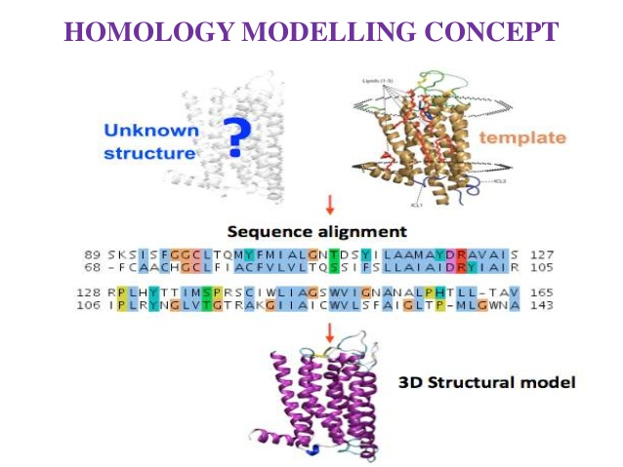
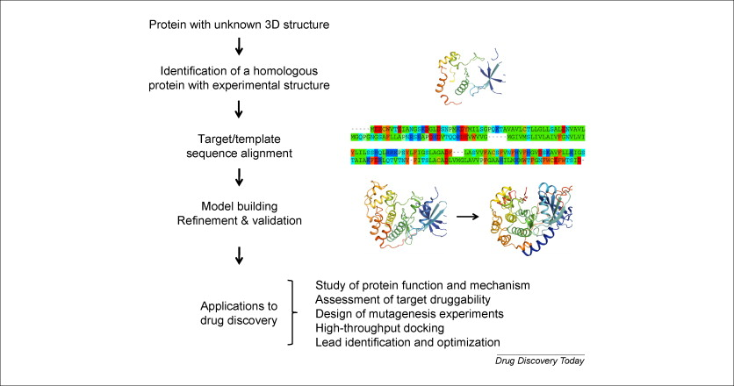
Homology Modelling

Slide 11
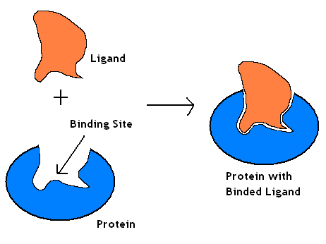
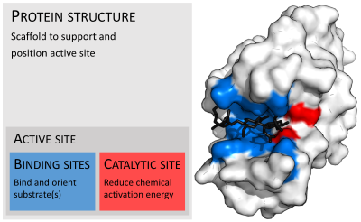
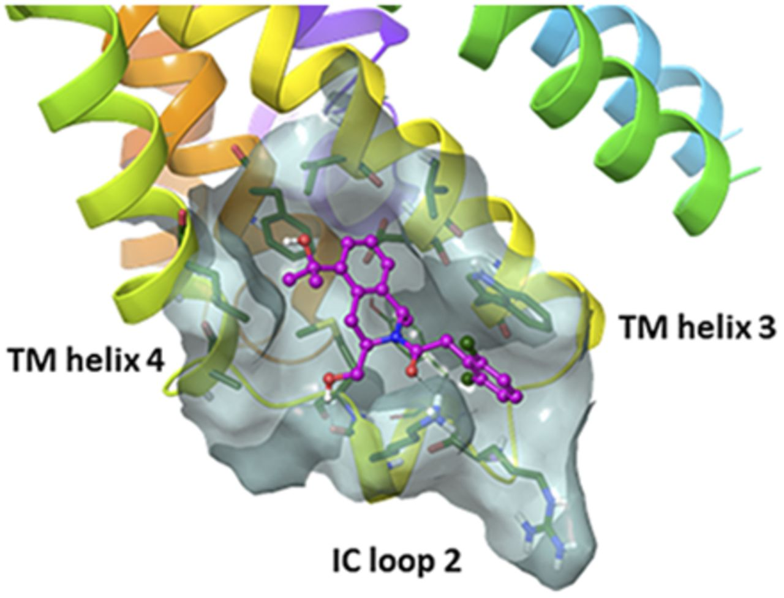
Binding Site

Slide 12
Lead Identification
Docking & Scoring?
To place a ligand (small molecule) into the binding site of a receptor in the manners appropriate for optimal interactions with a receptor.
To evaluate the ligand-receptor interactions in a way that may discriminate the experimentally observed mode from others and estimate the binding affinity.
complex
ligand
docking
scoring
receptor
X-ray structure
& ΔG
… etc

Slide 13
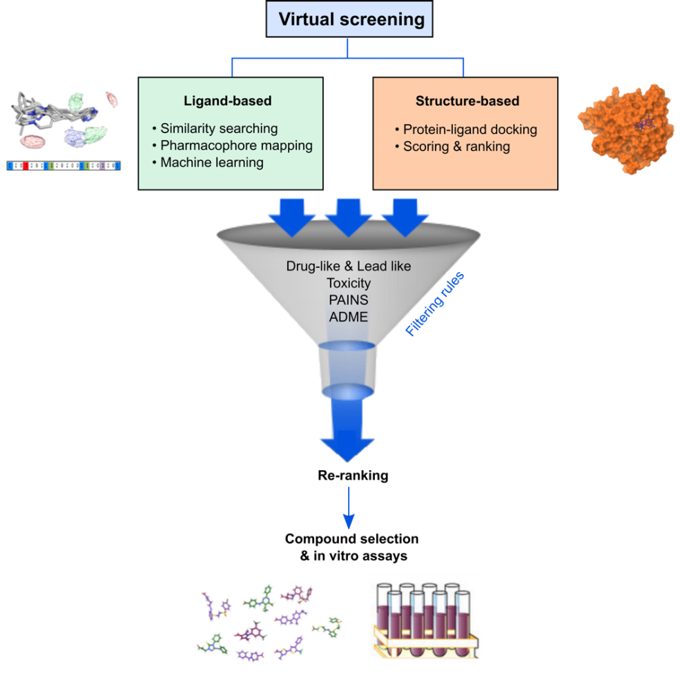
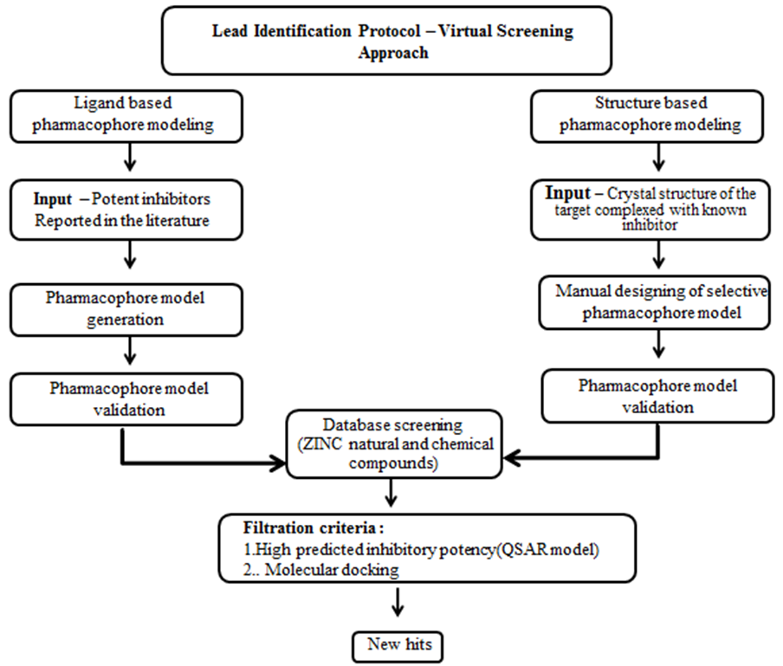
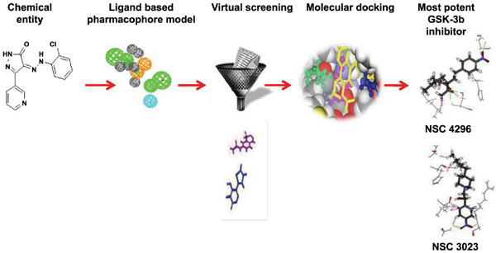
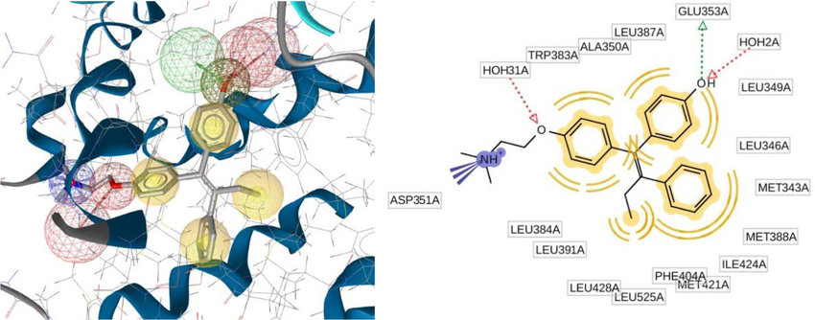
Lead Identification

Slide 14
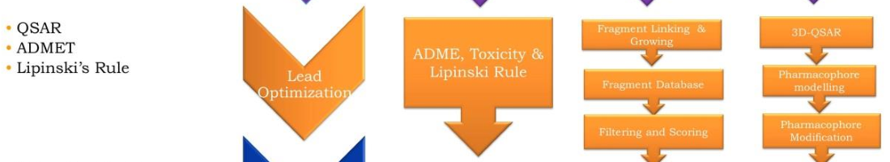
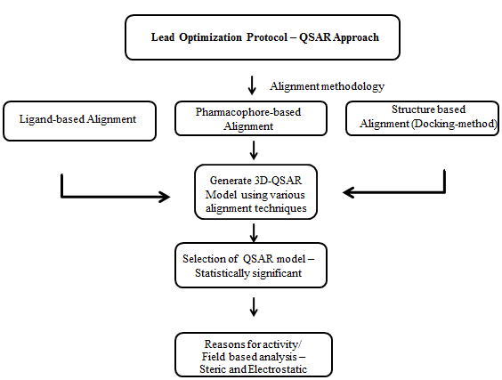
Lead Optimization

Slide 15
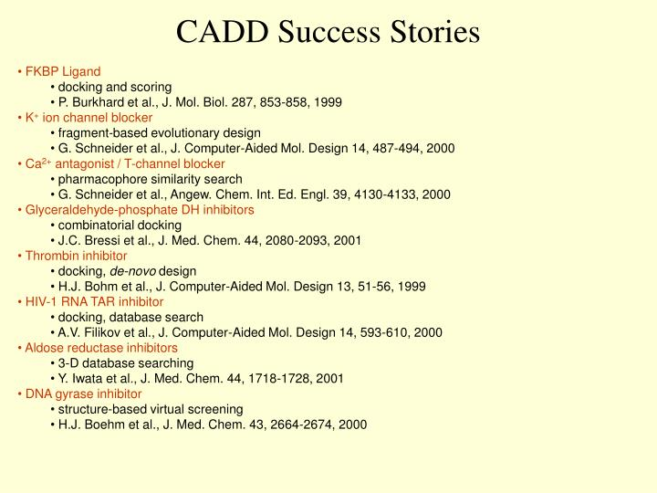

Slide 16
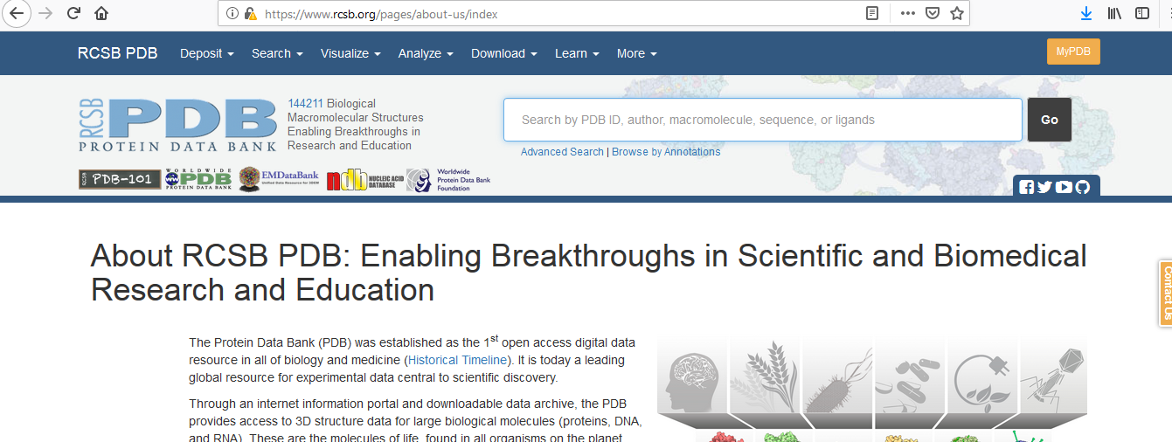
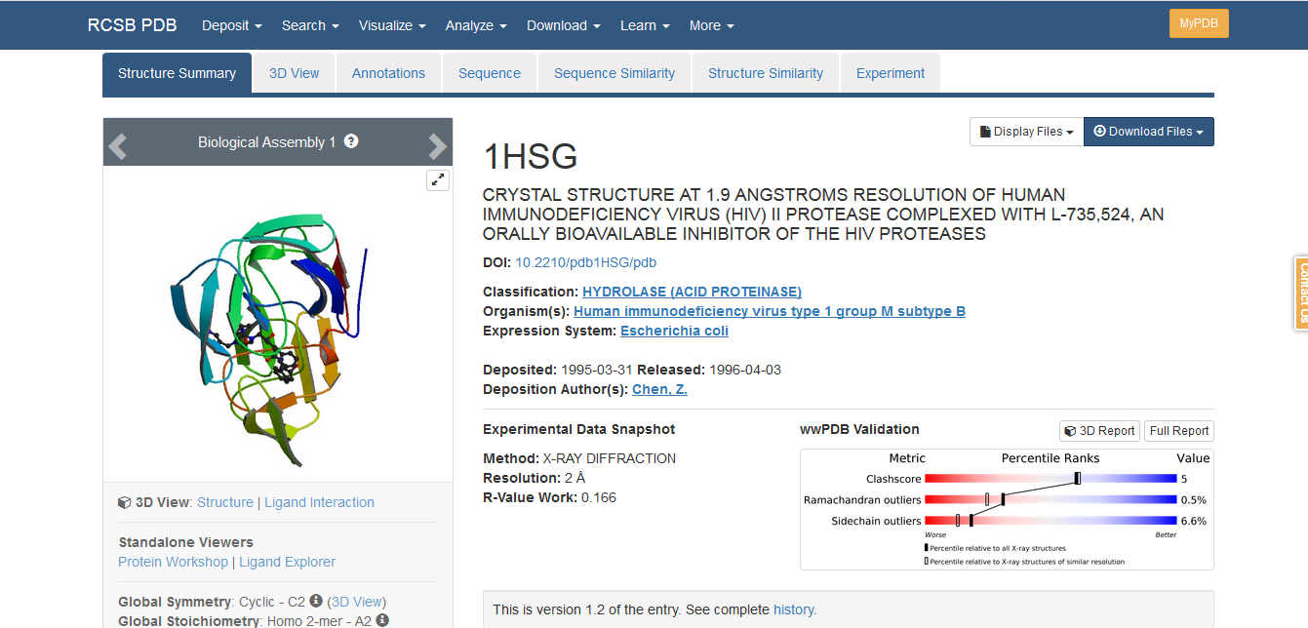

Slide 17
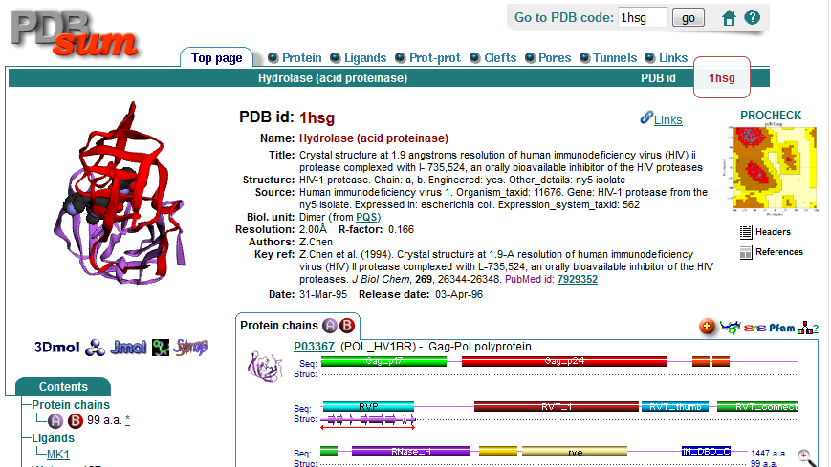

Slide 18
